Slide 1
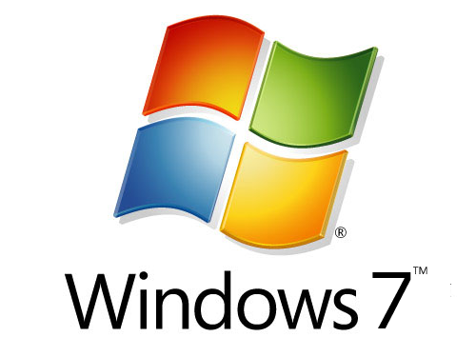
MTA 98-349
Windows OS Fundamentals
1
Notes:
1

Slide 2
Question
What tool could you use if your PC fails to start and you cannot access the Advanced Options menu?
2

Slide 3
Answer
Windows RE
(Windows Recovery Environment)
http://windows.microsoft.com/en-US/windows7/What-are-the-system-recovery-options-in-Windows-7
3

Slide 4
Question
How can you launch RDC (Remote Desktop Connection)?

Slide 5
Answer
Type: MSTSC
(Microsoft Terminal Services Console)
Start > All Programs > Accessories > Remote Desktop Connection

Slide 6
Question
What tool can you use to automatically run a script at a set interval?

Slide 7
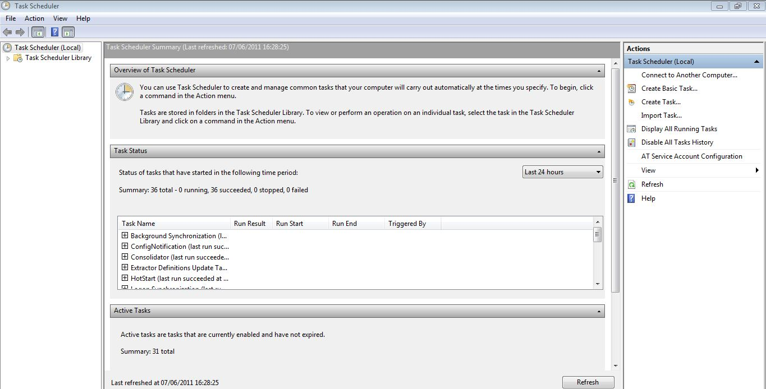
Answer
Task Scheduler

Slide 8
Question
What can you use the Windows 7 USB DVD Download Tool for?

Slide 9
Answer
The Windows 7 USB/DVD Download tool allows you to create a copy of your Windows 7 ISO file on a USB flash drive or a DVD. To create a bootable DVD or USB flash drive, download the ISO file and then run the Windows 7 USB/DVD Download tool. Once this is done, you can install Windows 7 directly from the USB flash drive or DVD.

Slide 10
Question
What is the Windows Mobility Center?

Slide 11
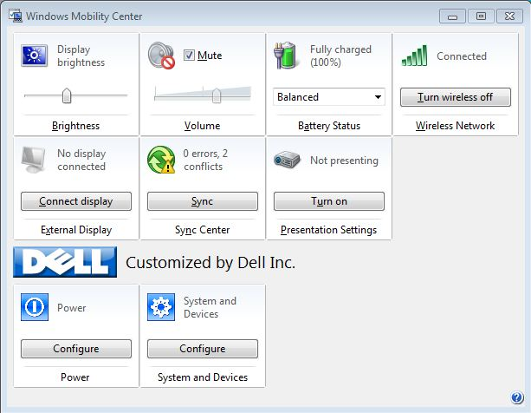
Answer
You can access all your mobile PC settings in one location e.g. you can adjust the speaker volume, check the status of your wireless network connection, and adjust the display brightness.

Slide 12
Question
What tool can you use to check how much physical memory is there in your PC?

Slide 13
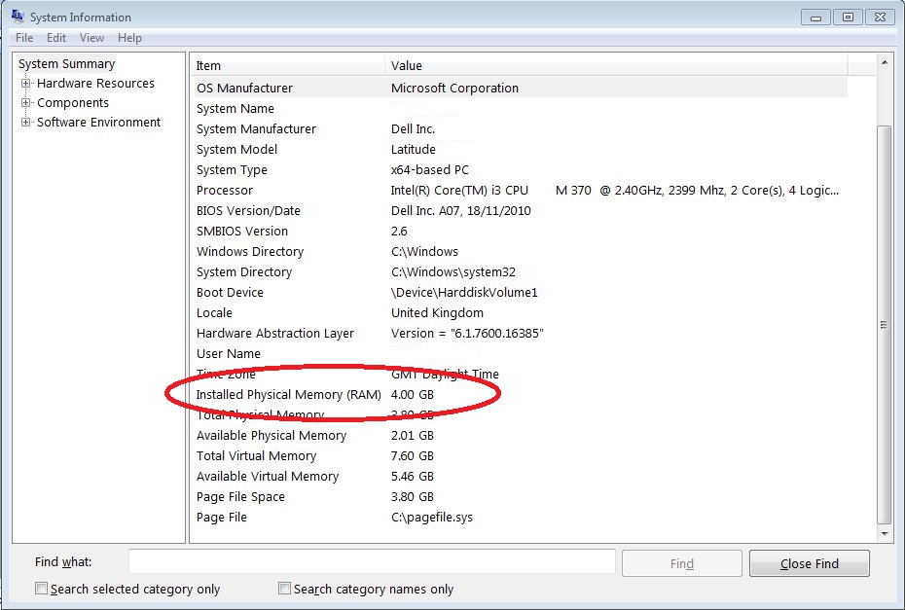
Answer
MSINFO32 (System Information)

Slide 14
Question
What do you use the Snipping tool for?

Slide 15
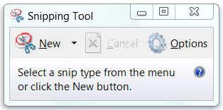
Answer
It captures a screen shot of anything on your desktop, like a picture or a section of webpage.
http://windows.microsoft.com/en-US/windows7/products/features/snipping-tool

Slide 16
Question
What is the main reason for using PowerShell?

Slide 17
Answer
It helps IT professionals control and automate the administration of Windows operating systems and applications that run on Windows

Slide 18
Question
What are Windows 7 Libraries?

Slide 19
Answer
Libraries are designed to make it easier to find, work with, and organise files which are scattered across your PC or network. A library can bring your files together in one place—no matter where it's actually stored .

Slide 20
Question
What can MSCONFIG (System Configuration) be used for?

Slide 21
Answer
To stop programs from starting up when you log into Windows.
http://windows.microsoft.com/en-US/windows7/Using-System-Configuration

Slide 22
Question
What is Reliability Monitor used for?

Slide 23
Answer
To measure hardware and software problems and other changes to your computer.
http://windows.microsoft.com/en-US/windows7/How-to-use-Reliability-Monitor

Slide 24
Question
What are the system requirements for Windows 7 64 bit?

Slide 25
Answer
CPU: 1 GHz
RAM: 2 GB
HDD: 20GB
DirectX 9 graphics device with WDDM 1.0 or higher driver

Slide 26
Question
What Windows 7 feature allows you to execute processes on a remote PC?

Slide 27
Answer
WinRM
Windows Remote Management

Slide 28
Question
What tool can you use to ensure that a PC cannot be used at a set time?

Slide 29
Answer
Parental Control
http://windows.microsoft.com/en-US/windows7/products/features/parental-controls

Slide 30
Question
What is IrDA?

Slide 31
Answer
Infra Red

Slide 32
Question
What feature in Windows Internet Explorer 9 allows you easily access websites that you regularly visit?

Slide 33
Answer:
Pin to Taskbar

Slide 34
Question
What do you require on your enterprise network in order to carry out a ZTI deployment of Windows?

Slide 35
Answer
System Center Configuration Manager (SCCM) 2007

Slide 36
Question
What is BitLocker?

Slide 37
Answer
It encrypts the entire drive that Windows and your data resides on.

Slide 38
Question
What is BitLocker To Go?

Slide 39
Answer
Allows you to encrypt portable storage devices like USB flash drives and external hard drives.

Slide 40
Question
What tool can you use to create VHDs?

Slide 41
Answer
Disk Management

Slide 42
Question
After you have created the VHD, what must you do before you can use it?

Slide 43
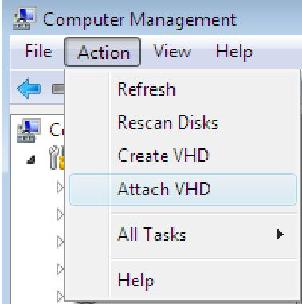
Answer
Attach it

Slide 44
Question
What would Parental Controls be used for?

Slide 45
Answer
Parent controls enables technicians to limit peoples access to specific Internet sites, games and applications. Control is based on users having their own logon accounts.

Slide 46
Question
A member of staff travel to different countries and wants to be able to view the time and weather in different countries. How would you advice them to do this in Windows 7?

Slide 47
Answer
Gadgets

Slide 48
Question
A user wants to conserve power when her machine is idle, what does the user need to set up?

Slide 49
Answer
Power Saver Mode

Slide 50
Question
What is PowerShell used for in Windows 7?

Slide 51
Answer
Automate a routine task

Slide 52
Question
A user needs to be able to access her files network files whilst she is working away from the office. What do you need to configure on her PC to enable this to happen?

Slide 53
Answer
Make her folders available offline

Slide 54
Question
A user is having difficulty accessing a remote computer whilst using Remote Desktop, what could be preventing the connection.

Slide 55
Answer
Incorrect port settings on the firewall

Slide 56
Question
When would you use Remote Desktop?

Slide 57
Answer
When you need to access another computer across the network to complete a task

Slide 58
Question
What are the minimum system requirements for 32-Bit Windows 7

Slide 59
Answer
Processor Speed: 1GHZ or faster
System Memory: 1GB
Available disk space: 16GB
Graphics: DirectX 9 graphics Adapter adapter with DDM 1.0 or higher driver

Slide 60
Question
What are the minimum system requirements for 64-Bit Windows 7

Slide 61
Answer
Processor Speed: 1GHZ or faster
System Memory: 2 GB
Available disk space: 20GB
Graphics: DirectX 9 graphics Adapter adapter with WDDM 1.0 or higher driver

Slide 62
Question
What is the maximum amount of RAM you can have if you have a 64-bit processor running Windows 7 Ultimate?

Slide 63
Answer
192 GB

Slide 64
Question
What is the best way to determine if a PC is capable of running Windows 7?

Slide 65
Answer
Use Microsoft’s Upgrade Advisor application

Slide 66
Question
Windows 7 supports an in-place upgrade from which Windows operating system (s)?

Slide 67
Answer
Windows Vista

Slide 68
Question
What process would you use to upgrade Windows 7 Professional to Windows 7 Ultimate?

Slide 69
Answer
Anytime Upgrade

Slide 70
Question
What process would you follow to install Windows 7 on a Windows XP machine

Slide 71
Answer
Perform an operating system migration using the User State Migration tool. Migrate the user profile data from the existing machine onto a fresh copy of Windows 7.

Slide 72
Question
True or False: The Sidebar application from Vista has gone but gadgets are still available?

Slide 73
Answer
True

Slide 74
Question
What are the two installation methods for Windows 7

Slide 75
Answer
Clean Installation
Upgrade

Slide 76
Question
Why might a you perform an in place upgrade rather than a clean installation?

Slide 77
Answer
You need to retain all the users applications, data files and existing configuration settings.

Slide 78
Question
What replaces the MS-DOS boot in Windows 7?

Slide 79
Answer
Windows PE 3.0

Slide 80
Question
What scenarios make use of Windows PE?

Slide 81
Answer
Custom Deployments
System Troubleshooting
System Recovery

Slide 82
Question
What would you use the Windows Easy Transfer (Migwiz.exe) tool for?

Slide 83
Answer
When migrating one computer to another

Slide 84
Question
When would you use the User State Migration tool?

Slide 85
Answer
When completing a large-scale enterprise deployment. Designed for migrating profile information for multiple users on multiple computers

Slide 86
Question
What are the eight preliminary procedures you should perform prior to upgrading to Windows 7?

Slide 87
Answer
Run Upgrade Advisor
Check the hardware compatibility list
Search for updated drivers
Check application compatibility
Check Disk Space
Ensure computer functionality
Perform a full backup
Purchase the correct version of Windows 7

Slide 88
Question
What are three ways to upgrade a Windows 7 computer to a new edition?

Slide 89
Answer
Purchase a retail version of a higher level Windows 7 edition
Purchase a Windows 7 product upgrade package.
Use the Windows Anytime Upgrade tool included with Windows 7

Slide 90
Question
True or False: You can upgrade a 32 –bit version of Windows 7 to a 64-bit version of Windows 7?

Slide 91
Answer
False

Slide 92
Question
Where can you find out about the speed of the processor on a Windows 7 PC.

Slide 93
Answer
System and Security – System

Slide 94
Question
You need to obtain updates for the operating system, where would you get them from?

Slide 95
Answer
Windows Update client enables computers running Windows 7 to automatically download and install operating system updates.

Slide 96
Question
Which feature ensures that you have the latest security patches?

Slide 97
Answer
Windows Update

Slide 98
Question
How would you check what updates had been installed on a PC?

Slide 99
Answer
From Windows Update, select View History Update.

Slide 100
Question
Which tool would you use to configure a Wireless network connection?

Slide 101
Answer
Control Panel>Network & Internet>Network & Sharing center

Slide 102
Question
What would administrators use WinRM for?

Slide 103
Answer
To execute programs from the command line on remote computers without having to open a Remote Desktop connection.

Slide 104
Question
You want to run scripts on a remote computer, what do you need to make is enabled on the remote computer?

Slide 105
Answer
Windows RM

Slide 106
Question
You computer has begun to run slowly, it takes time to open files, what could you do to improve the performance of the PC?

Slide 107
Answer
Run Disk Defragmenter

Slide 108
Question
A user wants to change the default homepage of Internet Explorer to show Google, how would you advise them to do it?

Slide 109
Answer
Tools>Internet Options, General Tab

Slide 110
Question
A user tries to install a new program, a dialogue pops up. What does the user need to enter in the dialogue box?

Slide 111
Answer
The user will need to type in a password with administrative rights.

Slide 112
Question
What feature in Windows 7 protects the machine against Spyware?

Slide 113
Answer
Windows Defender

Slide 114
Question
What is the definition of a Windows Service?

Slide 115
Answer
A program or process that runs in the background.

Slide 116
Question
A user wants to run a program on a remote machine, what feature of Windows 7 would they use?

Slide 117
Answer
Remote Desktop Connection

Slide 118
Question
An administrator wants to prevent users from using task manager, how would they achieve this?

Slide 119
Answer
Group Policy setting

Slide 120
Question
What does Microsoft Security Essentials (MSE) do on a Windows 7 PC?

Slide 121
Answer
Acts as the antivirus and antispyware software for the PC
(When using MSE, Windows Defender is turned off)

Slide 122
Question
Where in Control Panel will you find a shortcut to manage services on your computer?

Slide 123
Answer
The System and Security group under Administrative tools

Slide 124
Question
What is Upgrade Advisor used for in Windows 7?

Slide 125
Answer
To check for potential compatibility issues when upgrading to Windows 7

Slide 126
Question
You want your PC to recognise audio CDs and start playing without any user intervention. What should you configure?

Slide 127
Answer
Configure the auto play settings.

Slide 128
Question
What file system is designed to be used to transfer large files between a PC and portable devices?

Slide 129
Answer
exFAT

Slide 130
Question
What two steps should you perform to install a local printer directly attached to the PC?

Slide 131
Answer
Use the Add Printer Wizard
Follow the manufactures instructions

Slide 132
Question
You want the users to be able to print securely across the Internet. What protocol should they use?

Slide 133
Answer
Internet Printing protocol over HTTP

Slide 134
Question
There is a problem with a printer and I want to pause all print jobs in the queue. How to I do this?

Slide 135
Answer
Double click the printer, select Printer, select Pause

Slide 136
Question
Which feature enables you to change the display resolution of a computer monitor in Windows 7?

Slide 137
Answer
Appearance and Personalisation

Slide 138
Question
You need to change the boot order on your PC, how do you get into the BIOS to do this?

Slide 139
Answer
Restart the computer and press the system startup key prior to the machine booting into Windows.
(startup keys vary, it could be the Del key, it could be F10, or F2 amongst others)

Slide 140
Question
I want to make a copy of all system files on my machine, in case the machine becomes faulty. What Window component should I use?

Slide 141
Answer
System Image Backup

Slide 142
Question
What would the end result be if you ran disk cleanup on a PC?

Slide 143
Answer
The PC would have more free space due to the deletion of all temporary files

Slide 144
Question
Which tool would you use to disable programs that start automatically when windows starts?

Slide 145
Answer
System Configuration Tool (MSConfig)

Slide 146
Question
What do you need to configure to ensure your PC always has the latest patched for the operating system?

Slide 147
Answer
Windows Update

Slide 148
Question
What is the purpose of applying a service pack to a PC?

Slide 149
Answer
A service pack will resolve all known issues in the existing operating system software.

Slide 150
Question
You plan to upgrade a PC to Windows 7, which tools should you use to determine if the existing applications will work with Windows 7?

Slide 151
Answer
Application Compatibility Tool (ACT)

Slide 152
Question
You need to install a clean version of Windows 7 on PC that currently has Vista installed, however you wish to retain all file settings and programmes. Which installation path should you choose?

Slide 153
Answer
Use In Place upgrade and choose Upgrade

Slide 154
Question
Why does Windows hide some files by default?

Slide 155
Answer
To prevent accidental modification or deletion of important system files.

Slide 156
Question
A group of users need to view and modify a folder. Which item in the Share with menu should you use?

Slide 157
Answer
Homegroup, Read and Write

Slide 158
Question158
Everyone in a department needs access to a folder, however the folder must not be accessible to others. How do you achieve this?

Slide 159
Answer
Grant read write access to specific people in the department using the Share With menu option

Slide 160
Question
Which versions of Windows 7 allow you to encrypt files and folders using EFS?

Slide 161
Answer
Professional
Ultimate
Enterprise

Slide 162
Question
What tool can you use in order to create and manage your wireless connections?

Slide 163
Answer
Network and sharing Center

Slide 164
Question
What file system is recommended to use for Windows 7?

Slide 165
Answer
NTFS

Slide 166
Question
What command can you use to convert C:\ from FAT to NTFS?

Slide 167
Answer
Convert C:/fs:ntfs

